Slide 1
Effectiveness and Efficiency in Exhaustive Searches
7 and 21 October 2021
Medical Library Association - Online
www.wichor.nl/20211007
menti.com 7884 0692
Please already make sure you have access to your subscribed databases via your institute (embase.com or Medline/ Embase via Ovid)

Slide 2
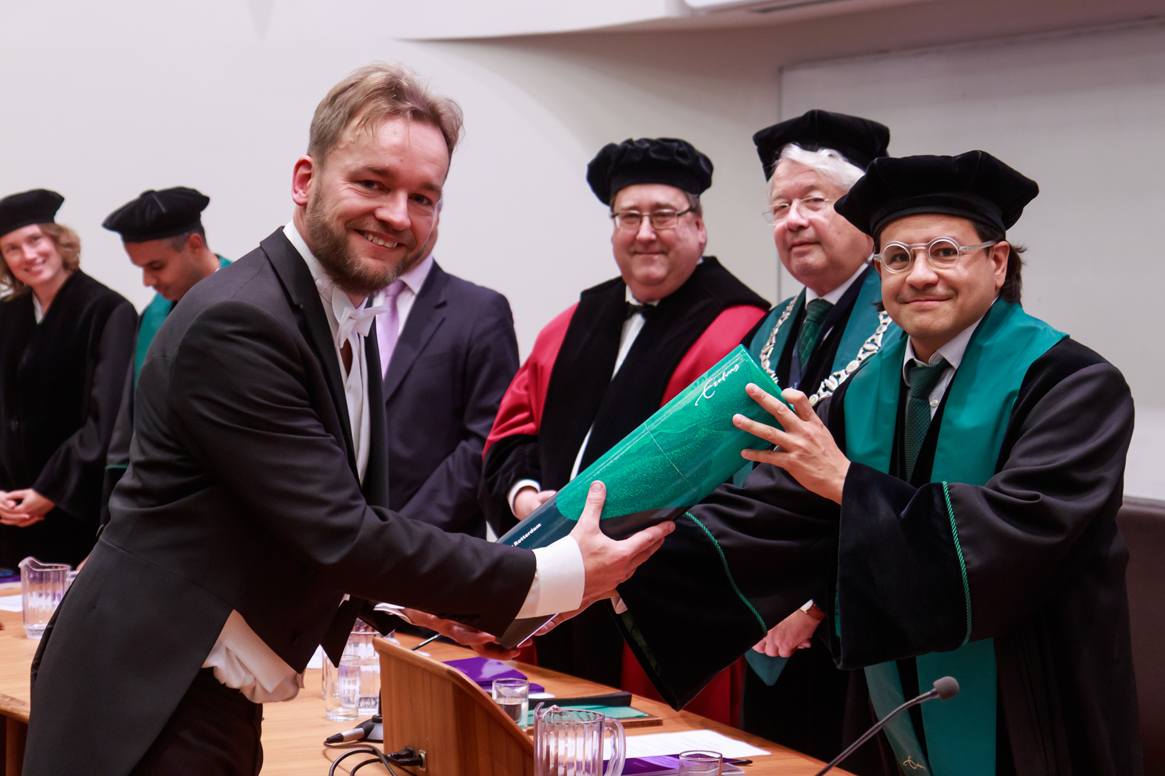
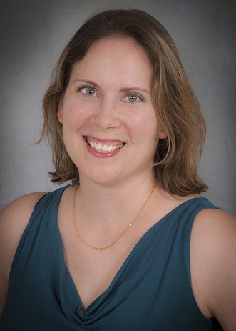
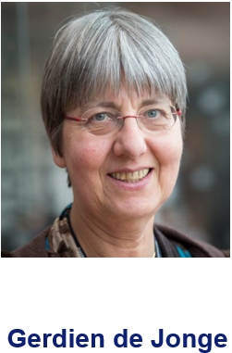
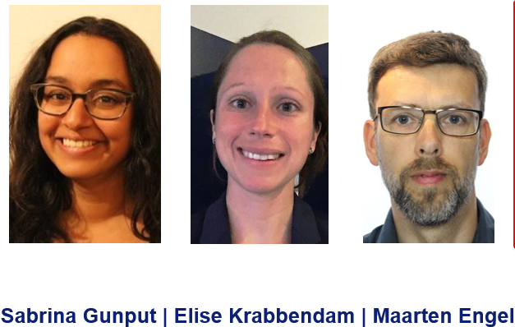
Who am I?
Bachelor Biology (1998)
Bachelor Information Services and Management (2002)
Information Specialist Erasmus MC University Medical Center Rotterdam, the Netherlands (2009-present)
PhD thesis “Serving Evidence Syntheses” (2019)
Melissa Rethlefsen
Head Uiversity of New Mexico Health Sciences Library & Informatics Center

Slide 3
How do your clients search?
Vitamins and hormones within the field of clinical dermatology
How many references do you expect for this topic?
Go to www.menti.com and use the code 7884 0692

Slide 4
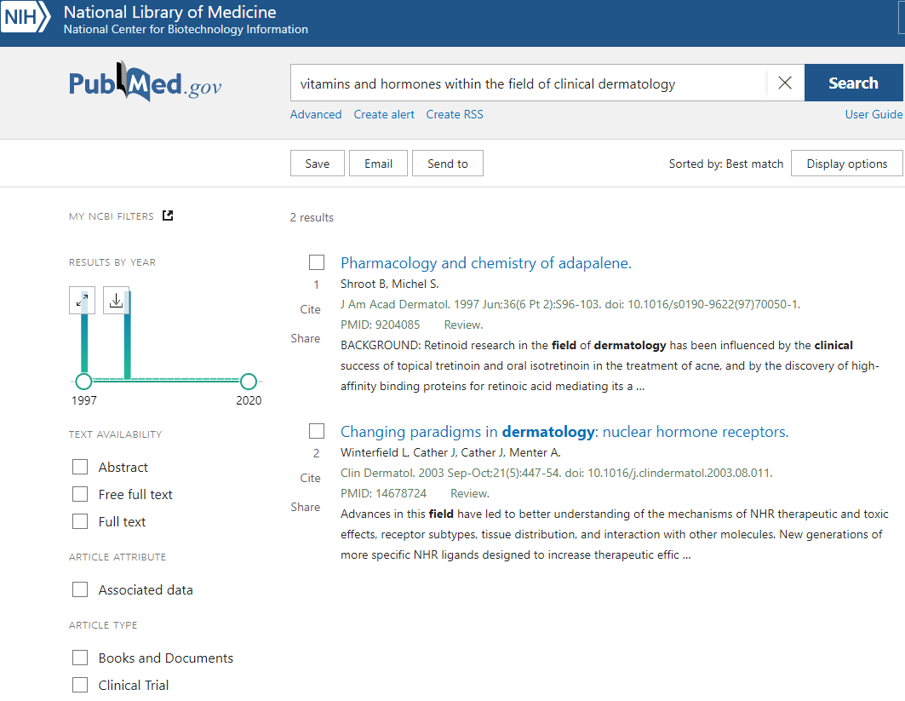
vitamins and hormones within the field of clinical dermatology
2 results

Slide 5
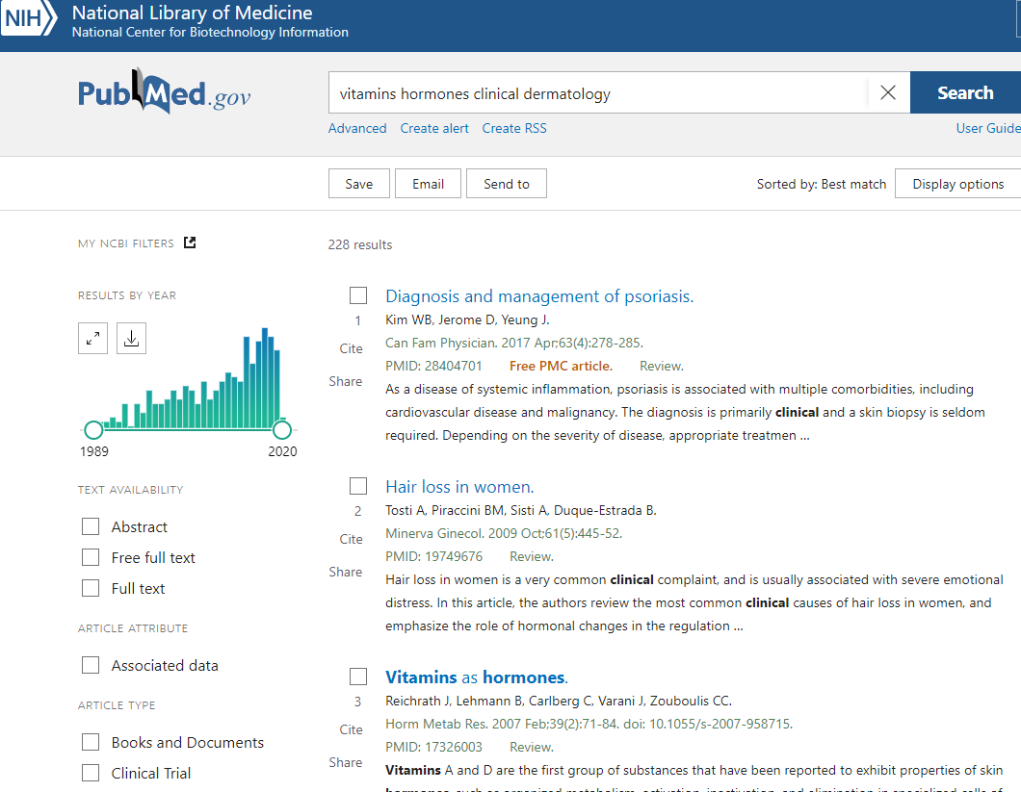
vitamins hormones clinical dermatology
228 results

Slide 6
clinical vitamins hormones dermatology
244 results

Slide 7
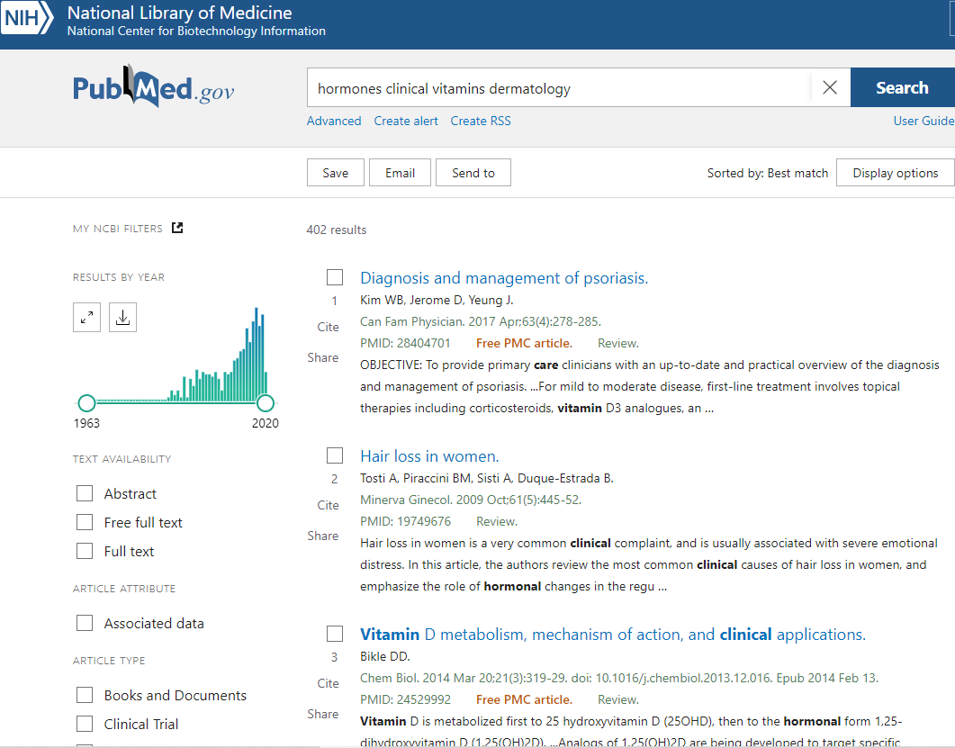
hormones clinical vitamins dermatology
402 results

Slide 8
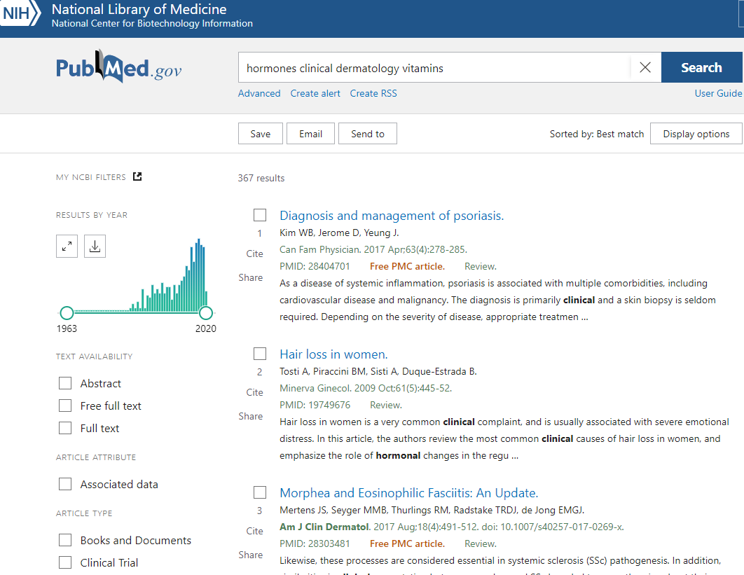
hormones clinical dermatology vitamins
367 results

Slide 9
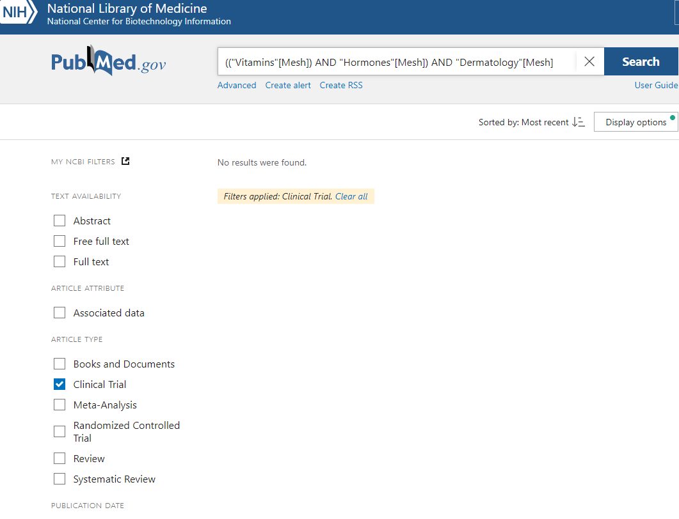
(("Vitamins"[Mesh]) AND "Hormones"[Mesh]) AND “Dermatology"[Mesh]
Filters: Clinical Trial
0 results

Slide 10
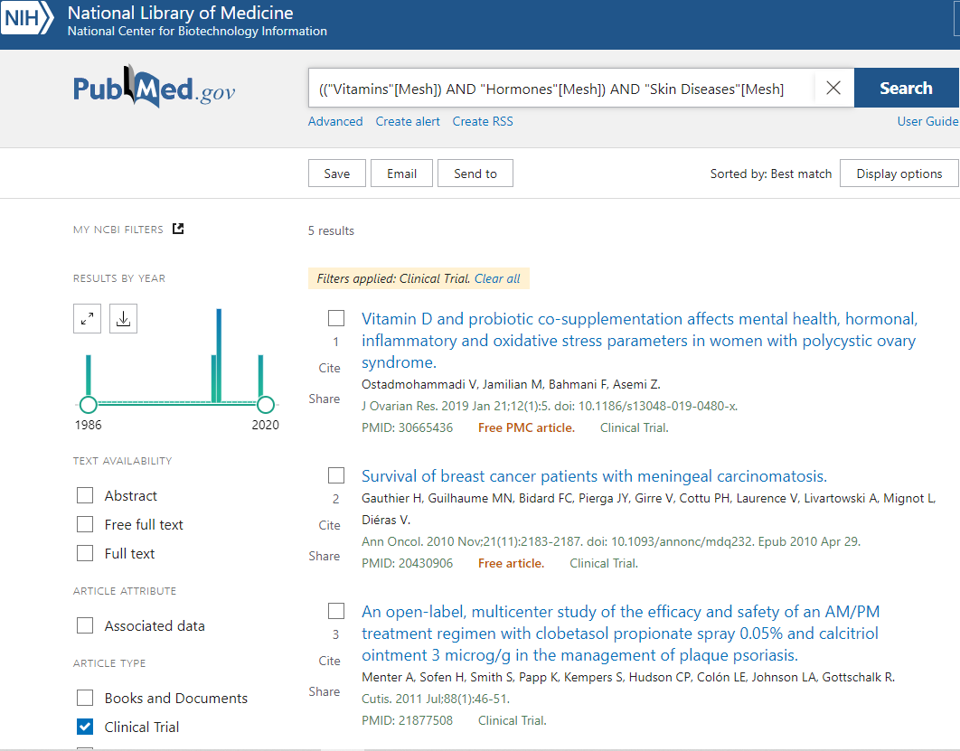
(("Vitamins"[Mesh]) AND "Hormones"[Mesh]) AND "Skin Diseases"[Mesh]
Filters: Clinical Trial
5 results

Slide 11
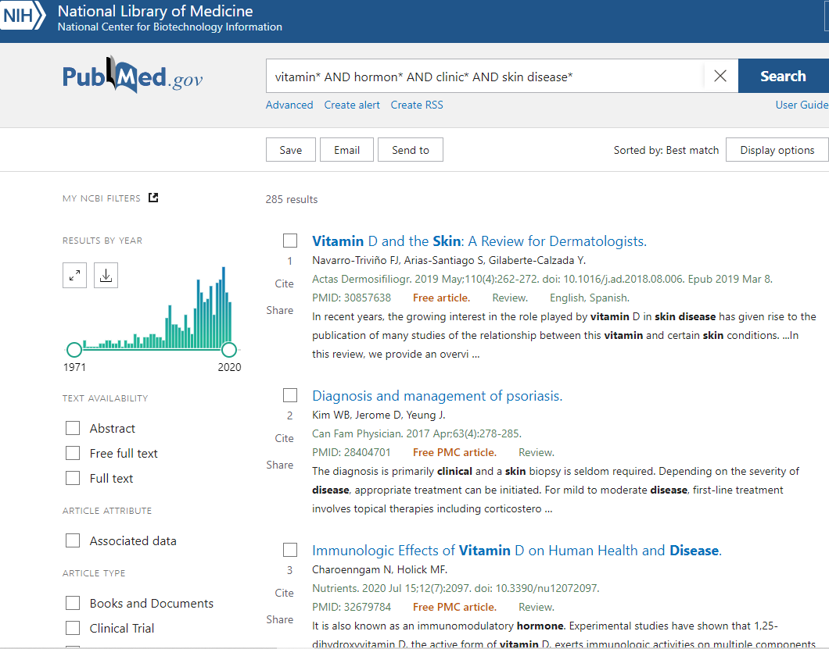
vitamin* AND hormon* AND clinic* AND skin disease*
285 results

Slide 12
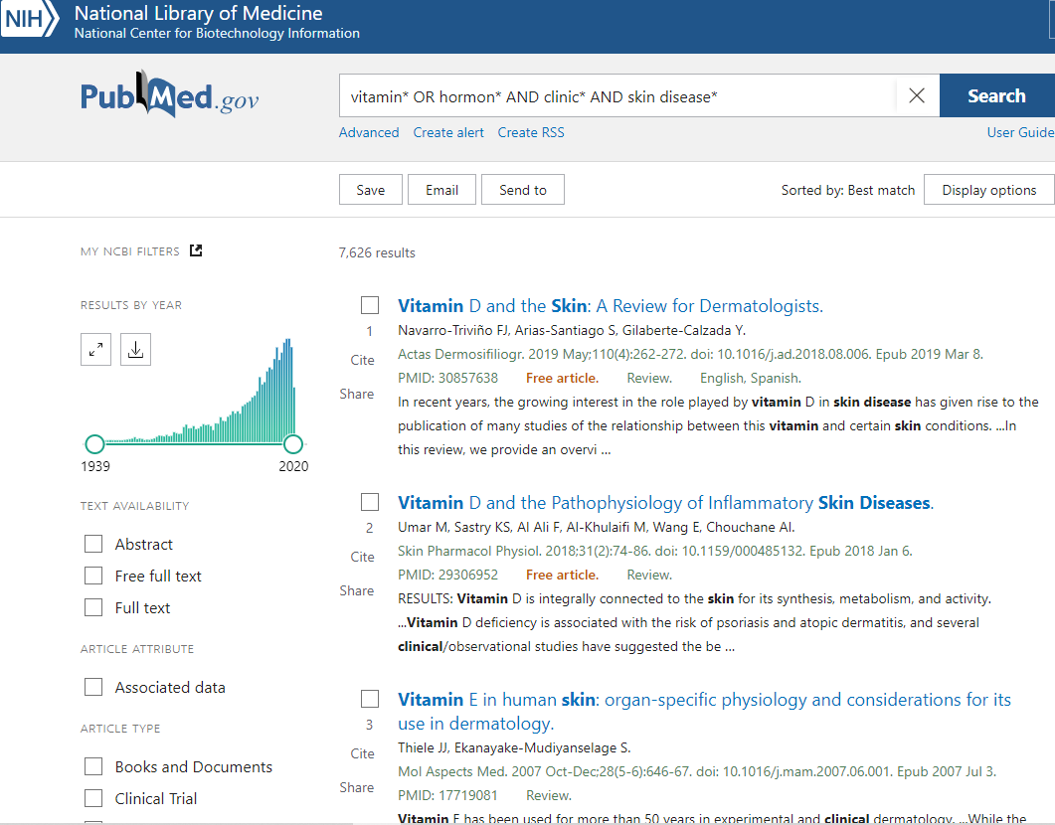
vitamin* OR hormon* AND clinic* AND skin disease*
7,626 results

Slide 13
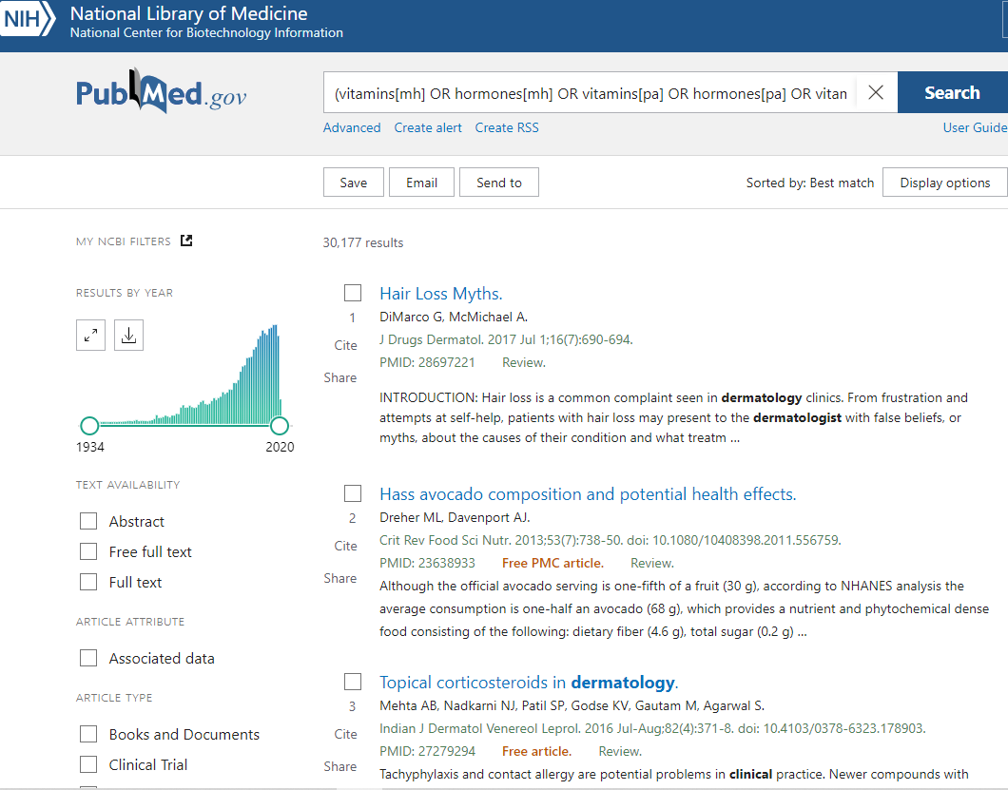
(vitamins[mh] OR hormones[mh] OR vitamins[pa] OR hormones[pa] OR vitamin*[tiab] OR hormon*[tiab]) AND ("Clinical Study" [pt] OR clinical medicine[mh] OR Clinical Studies as Topic[mh] OR clinical*[tiab]) AND (dermatology[mh] OR dermatol*[tiab] OR skin diseases[mh] OR skin-disease*[tiab])
30,177 results

Slide 14
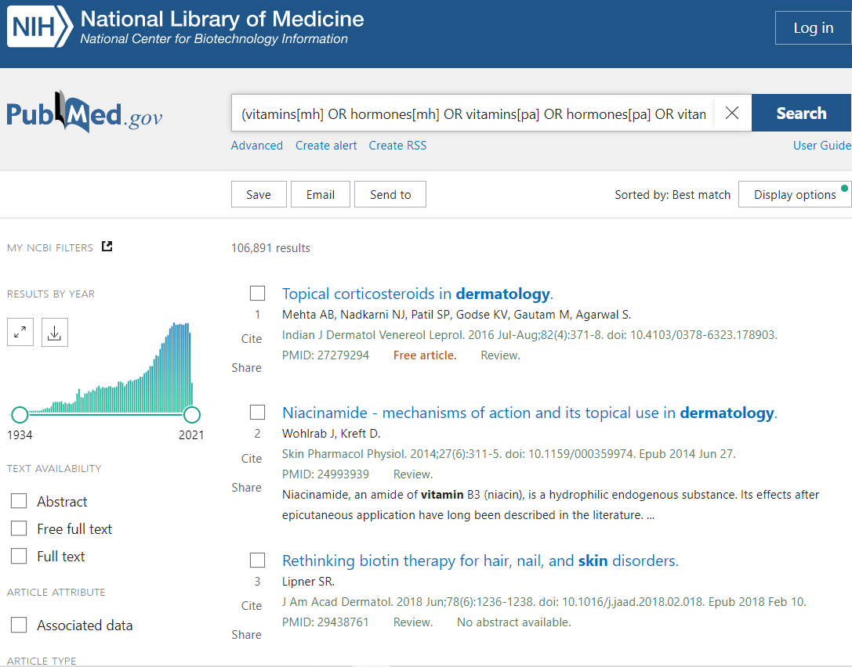
(vitamins[mh] OR hormones[mh] OR vitamins[pa] OR hormones[pa] OR vitamin*[tiab] OR hormon*[tiab]) AND (dermatology[mh] OR dermatol*[tiab] OR skin diseases[mh] OR skin-disease*[tiab])
106,891 results

Slide 15
What would you find an acceptable sensitivity/ specificity?
How do you think you as a group performed?
Go to menti.com

Slide 16
#terms
3
3
3
4
6
6
8
8
10
11
15
15
18
20
22
22
31
51
#results
6
247
366
485
686
731
817
908
973
1247
1665
2001
3833
6424
10454
16196
18958
22482 26806 43586
60158
67969
69807
105399
187366
sensitivity
0%
0%
0%
0%
1%
1%
1%
1%
1%
1%
1%
2%
2%
3%
3%
4%
10%
11%
13% 25%
25% 40%
45%
78%
100%

Slide 17
Frequent errors
14 | Not including skin diseases in the search | 5%
10 | Combining hormones AND vitamins | 2%
2 | Not including pharmacological action in PubMed | 82%
2 | Adding an element for clinical in the search | 32%
5 | Too broad terms
3 | Syntax Errors
2 2 | Did not explode MeSH terms Combined MeSH with subheading
1 | Other extra element

Slide 18
Think through question
Can you think of a research question where it is better to search Vitamins AND hormones?

Slide 19
What is the effect of vitamin supplementation on the disease severity of hormonal dermatological complaints?

Slide 20
(Vitamin OR suppletion)
AND
(Hormones OR hormonal skin diseases)
AND
(skin diseases)

Slide 21
Agenda
Analyzing research question (elements)
Finding search terms
Database and interface choice
Creating a basic search strategy
Working with long lists of terms
Finding mistakes
Optimizing a search strategy
Translating queries between databases
Evaluation

Slide 22
Agenda
Analyzing research question (elements)
Finding search terms
Database and interface choice
Creating a basic search strategy
Working with long lists of terms
Finding mistakes
Optimizing a search strategy
Translating queries between databases
Evaluation

Slide 23
Clear and focused research question
CLABSI rate for BIPoC patients in the PICU
Regarding Adult completely edentulous patients over 18 years’ old who are treated with either maxillary or mandibular implant supported overdenture, does ball and socket attachment result in more marginal bone loss in comparison with locator attachment?
Clinician burnout and wellbeing.
TOO VAGUE
TOO SPECIFIC
TOO BROAD
23
Notes:
23

Slide 24
Concepts and Elements
Identify Concepts in your research question
Group related Concepts into Elements Palliative Care OR Terminal illness OR Terminally ill OR Hospice
Choose the optimal combination of Elements to use in the search

Slide 25
Analyzing research question
Watch out for bias:
Specific characteristics →Duration of breastfeeding and intelligence
Judgement →Poor family functioning, harsh parenting and bullying behavior of children/adolescent
Watch out for duplicates:
Pre-eclampsia AND pregnant AND women
Lichtenstein therapy AND inguinal hernias
Notes:
25

Slide 26
Research question: Does eating broccoli help in the prevention of cancer?
broccoli
prevention
cancer
specific
general
important
brassica
vegetables
cancer
Go to menti.com
broccoli
prevention
unimportant
Which elements would you use?

Slide 27
Does exercise therapy such as physiotherapy improve quality of life and mobility in elderly patients with hip osteoarthritis?
Exercise 3

Slide 28
Does exercise therapy such as physiotherapy improve quality of life and mobility in elderly patients with hip osteoarthritis?
Exercise 3
Exercise therapy/ physiotherapy
Qol / mobility
Elderly
Hip Osteoarthritis
specific
general
important
Osteoarthritis
Exercise therapy/ physiotherapy
Hip Osteoarthritis
Qol / mobility
Elderly
unimportant

Slide 29
Elements used (frequency)
hip osteoarthritis (14)
osteoarthritis (4)
exercise therapy OR physiotherapy (9)
exercise OR physiotherapy (9)
exercise (1) physiotherapy (1)
quality of life OR mobility (9)
quality of life OR mobility OR improvement (4)
improvement (3) quality of life (2) mobility (2)
elderly (15) patients (4)
quality of life OR physiotherapy OR exercise therapy OR improvement (1)
hip osteoarthritis OR elderly (1)
elderly OR patients (1)
20 answers
19 variations
#Elements | frequency
2 | 1
3 | 5
4 | 8
5 6 | 5 1

Slide 30
Effects of your choices:
Basic search: 4867
Specific Hip osteoarthritis 741 (15%)
NOT (knee/spine NOT hip) 2489 (51%)
Exercise 8182 (168%)
(hip oa AND exercise) 1150 (24%)
Adding Elderly 2040 (42%)
No physiotherapy 2028 (42%)
Adding Quality of Life 955 (20%)

Slide 31
Agenda
Analyzing research question (elements)
Finding search terms
Database and interface choice
Creating a basic search strategy
Working with long lists of terms
Finding mistakes
Optimizing a search strategy
Translating queries between databases
Evaluation

Slide 32
Finding search terms
# terms (of 18) 2 | frequency 2
3 | 5
4 | 2
5 | 3
6 | 1
7 | 0
8 | 3
9 | 1
10 | 2
11 | 1
Kidney dialysis

Slide 33
Exercise 2
Renal Dialysis [MeSH] (16/18)
Renal Dialy* (12)
Hemodialy* (13)
Extracorporeal Dialy* (6)
Kidneys, Artificial [mesh] (6)
Artificial Kidney* (3)
Blood Dialy* (3)
Hemodiafiltration* (4)
Peritoneal Dialy* (8)
Acetate Free Biofiltrat* (2)
CAPD (3)
Renal Replacement Therapy[mesh:noexp] (0)
Renal Replace* (3)
Kidney Replace* (1)
Haemodialy* (1)
Haemodiafiltrat* (1)
(Dialysis [mesh] AND (Kidney Diseases [mesh] OR Kidney [mesh])) (3)
Kidney dialy* (11)

Slide 34
Frequent errors
Narrower terms as MeSH terms
"Peritoneal Dialysis"[Mesh]
Too broad terms
Chronic Kidney Failure
Phrases contain words already searched
Home Hemodialys*
Entry terms with comma’s
Dialysis, Renal

Slide 35
If you don’t find good thesaurus terms
Split an element in two parts
Chlorhexidine bathing
Use pubreminer
virtual care
Think of specific examples for a broad topic
Medical forensic services
Truncate your search when searching PubMed MeSH interface
If this all fails:
Use your own terms as title abstract and optimize later
Bariers

Slide 36
Difference Emtree / Mesh
Emtree has:
More specific terms (night shift worker, Elder Abuse Suspicion Index)
Too broad alternatives (triage)
Combination terms (chronic stress)
Candidate terms (cancer care/ inpatient rehabilitation/residential aged care facility)
Subheadings are harder to find
MeSH has:
Sometimes more specific terms (Malocclusion, Angle Class III)
Pharmacological action (Anti-Bacterial Agents)
Supplementary concepts
Previous indexing (Electronic Nicotine Delivery Systems)
Related terms (Domestic Violence)
Scope notes

Slide 37
Agenda
Analyzing research question (elements)
Finding search terms
Database and interface choice
Creating a basic search strategy
Working with long lists of terms
Finding mistakes
Optimizing a search strategy
Translating queries between databases
Evaluation

Slide 38
Databases / interface choice
What’s your favorite database / interface to start?
Why?
Menti.com
Advice:
Embase.com
Embase Ovid
Medline Ovid
Medline EBSCO/ProQuest
PubMed
Ovid | 11
PubMed | 3
Embase.com | 1
Unknown | 3

Slide 39
Agenda
Analyzing research question (elements)
Finding search terms
Database and interface choice
Creating a basic search strategy
Working with long lists of terms
Finding mistakes
Optimizing a search strategy
Translating queries between databases
Evaluation

Slide 40
Practicum search syntax (handouts)
Embase.com
/exp
():ab,ti
(() NEAR/n ())
Ovid
exp …/
().ab,ti.
(() ADJn ())
(Phrase-trunc*)
PubMed
[mesh]
[tiab]
(() AND ())
Phrase-trunc*
Hip Osteoarthritis
Exercise therapy

Slide 41
Considerations
Explode a broad term or not?
Truncate a term or not?
How broad should proximity be?
Combination of hyphens and proximity?
Antithrombotic agents OR Anti-thrombotic drugs
((Antithrombotic* OR Anti-thrombotic*) NEAR/3 (agent* OR drug*))

Slide 42
Tips
Edit in Word
Code & parentheses before terms
Cursor positioning with arrow keys; paste with Ctrl-V
Don’t remove parentheses, add for new element or title/ abstract section
Prepare proximity statement for phrase variations
combine similar proximities
Use hypens in (truncated) phrases without variations
Copy from thesaurus
use find and replace ^p to create managable lists
Start with ab,ti add other fields only in the end

Slide 43
Homework for session 2
Choose one of the research questions given on the website
Determine which elements to use (max 4)
Per element, use about 10 terms, the most important ones to start with. The rest will be added by optimization.
Using the handouts, create a basic search strategy for your first database with the new method
Send the results to w.bramer@erasmusmc.nl (asap)
After that you can have a try with your own question

Slide 44
Effectiveness and Efficiency in Exhaustive Searches – Part 2
7 and 21 October 2021
Medical Library Association - Online
www.wichor.nl/20211007
menti.com 7884 0692
Please already make sure you have access to your subscribed databases via your institute (embase.com or Medline/ Embase via Ovid)

Slide 45
The method
Your experiences?
Problems?
Feedback?
Menti.com 7884 0692

Slide 46
Demonstration
Your most popular topic:
Patient adherence of anticoagulants for atrial fibrillation

Slide 47
Feedback on homework
Frequent errors:
No hypens in phrases | 5
Semi-Multiline searches | 4
Missing parentheses for ab,ti | 3
Errors in Boolean operators | 3
Not using proximity | 3
Starting with too broad terms | 2
Extra parentheses added | 1
Errors in elements | 1
Parentheses errors in proximity | 1
Missing Explosion | 1
Copy from the database to word | 1

Slide 48
Topic 1 | # terms 17 | # results 210
 | 47 | 569
 | 53 Spec Sens | 1536 504 3779
Topic 3 | # terms 15 | # results 919
 | 19 | 2028
 | 23 | 2368
 | 24 | 2924
 | 26 | 3225
 | 38 | 3372
 | 56 | 5057
 | 63 Spec Sens | 27427 1984 3441
Topic 2 | # terms 18 | # results 53
 | 49 Spec Sens | 213 146 1282
Topic 4 | # terms 19 | # results 60
 | 20 | 2272
 | 24 | 3741
 | 26 Spec Sens | 6307 2189 4799

Slide 49
sensitivity
2%
8%
21%
27%
34%
36%
42%
68%
90%
93%
99%
99%
99%
99%
100%
100%
100%
specificity
1%
36%
38%
49%
61%
64%
71%
73%
73%
79%
85%
87%
95%
100%
100%
100%
100%

Slide 50
Agenda
Analyzing research question (elements)
Finding search terms
Database and interface choice
Creating a basic search strategy
Working with long lists of terms
Finding mistakes
Optimizing a search strategy
Translating queries between databases
Evaluation
Exercise 5
Exercise 6
Exercise 7

Slide 51
Which databases are most important for SRs?
menti.com 7884 0692

Slide 52
When to use what databases?
Embase.com (Embase and Medline)
Thorough optimization of thesaurus terms and title / abstract terms in search strategy
Macro and edit thesaurus
Add extra terms
Remove thesaurus
Macro and edit
Medline (Ovid incl ePub)
MeSH terms in PubMed / Optimization
Cochrane library
Google Scholar
Macro
edit thesaurus
Macro and edit thesaurus
Web of Science
Liliacs / Scielo / Popline / Trials Registers / WorldCat
Basic search strategy with AND, OR parentheses based on basic Google terms
PsycINFO (OvidSP)
CINAHL (EBSCO)
Macro
Scopus
DEMO (+ PRACTICUM)

Slide 53
Agenda
Analyzing research question (elements)
Finding search terms
Database and interface choice
Creating a basic search strategy
Working with long lists of terms
Finding mistakes
Optimizing a search strategy
Translating queries between databases
Evaluation

Slide 54
Too few or too many?
What number of references would you consider too few?
What number would you consider too many?
Go to menti.com and use the code 7884 0692

Slide 55
Too few results?
Add extra terms
OR study type
55
Notes:
55

Slide 56
Which articles can answer your question?
Go to menti.com and use the code 7620 4971
Facilitators and barriers in preconception care
Evaluation studies of preconception care
(Preconception Care[mh] OR Preconception-Care*[tiab]) AND (Facilitator*[tiab] OR barrier*[tiab])
→ 116 results
(Preconception Care[mh] OR Preconception-Care*[tiab]) AND (Facilitator*[tiab] OR barrier*[tiab] OR Evaluation Study [Publication Type] OR Evaluation*[tiab])
→ 279 results
Notes:
56

Slide 57
Which articles can answer your question?
Go to menti.com and use the code 7620 4971
Predictive factors for oronasal fistulas in children treated for cleft lip
Follow up studies of children treated for cleft lip
(Prognosis[mh] OR Risk Factors[mh] OR prognos*[tiab] OR predict*[tiab] OR risk-factor*[tiab]) AND (Oral Fistula[mh] OR fistula*[tiab]) AND (Cleft Lip[mh] OR Cleft-Lip*[tiab])
→ 128 results
(Prognosis[mh] OR Risk Factors[mh] OR prognos*[tiab] OR predict*[tiab] OR risk-factor*[tiab] OR Follow-Up Studies[mh] OR Follow-Up[tiab]) AND (Oral Fistula[mh] OR fistula*[tiab]) AND (Cleft Lip[mh] OR Cleft-Lip*[tiab])
→ 186 results
Notes:
57

Slide 58
Too few results?
Add extra terms
OR study type
OR Broad Filter
Generalize specific elements
Drop less important elements
2 elements → 1 element (A) AND (B) → (A OR B)
58
Notes:
58

Slide 59
Too few results?
Too many results?
Add extra terms
OR study type
OR Broad Filter
Generalize specific elements
Drop less important elements
2 elements → 1 element (A) AND (B) → (A OR B)
Major for SRs?
Remove too general terms
Specify general elements
Add an extra element
AND study type
AND Narrow Filter
1 element → 2 elements (A OR B) → (A) AND (B)
Use [mesh:noexp]
Filter for date or language?
Use [mj] and [ti]
Remove noise by using NOT
59
Notes:
59

Slide 60
Safe use of NOT
NOT out a very specific element:
NOT (neoplasms/therapy[mj] OR cancer-therap*[ti])
NOT out noise only on a specific term:
… hiv OR (aids NOT hearing-aids) OR …
Or use a double NOT

Slide 61
Use a double NOT
NOT (animals[mh] NOT humans[mh])
Animals[mh]
Humans[mh]

Slide 62
Use a double NOT
NOT (child[mh] NOT adult[mh])
Child[mh]
Adult[mh]

Slide 63
Use a double NOT
AND (heart ventricles[mh] NOT (left-ventric*[tiab] NOT right-ventric*[tiab]))
left-ventric*
[tiab]
right-ventric*
[tiab]
heart ventricles[mh]

Slide 64
Did you find everything?
Success of the search depends on:
The contents of the databases available and used
The quality of indexing by the databases
The quality and characteristics of the search engine
The quality and presence of an abstract
The quality of the search and experience of the searcher

Slide 65
Success factors / Time savers
Single-line search strategies in Word

Slide 66
Set numbers or one-liners?
Well structured?
#1 brassica [mh]
#2 brassica* [tiab]
#3 broccoli [tiab]
#4 #1 OR #2 OR #3
#5 neoplasms [mh]
#6 neoplas* [tiab]
#7 cancer* [tiab]
#8 tumor* [tiab]
#9 #5 OR #6 OR #7 OR #8
#10 #4 AND #9
#11 animals[mh]
#12 humans[mh]
#13 #11 NOT #12
#14 #11 NOT #13
#15 #10 NOT #14
Unstructured?
(brassica [mh] OR brassica* [tiab] OR broccoli [tiab]) AND (neoplasms [mh] OR neoplas* [tiab] OR cancer* [tiab] OR tumor* [tiab]) NOT (animals[mh] NOT humans [mh])
66

Slide 67
Set numbers or one-liners?
Unstructured!
#1 brassica [mh]
#2 brassica* [tiab]
#3 broccoli [tiab]
#4 #1 OR #2 OR #3
#5 neoplasms [mh]
#6 neoplas* [tiab]
#7 cancer* [tiab]
#8 tumor* [tiab]
#9 #5 OR #6 OR #7 OR #8
#10 #4 AND #9
#11 animals[mh]
#12 humans[mh]
#13 #11 NOT #12
#14 #11 NOT #13
#15 #10 NOT #14
#16 Cauliflower*[tiab]
#17 #1 OR #2 OR #3 OR #16
#18 #17 AND #9
#19 #18 NOT #14
(#20 #19 NOT #15)
Well structured!
(brassica [mh] OR brassica* [tiab] OR broccoli [tiab] OR cauliflower*[tiab]) AND
(neoplasms [mh] OR neoplas* [tiab] OR cancer* [tiab] OR tumor* [tiab]) NOT (animals[mh] NOT humans [mh])
67

Slide 68
Success factors / Time savers
Single-line search strategies in Word
Direct feedback of researcher
Optimization techniques
Macros for syntax translation
Database order and interface choice
Experience (be pro-active)
Second computer screen
Computer literacy
keyboard short cuts (supplement 3)

Slide 69
Your experience
How long does it take to create an SR search?
How many SR searches do you do per year?
How many of your institute’s SRs has your library assisted?
Menti.com

Slide 70
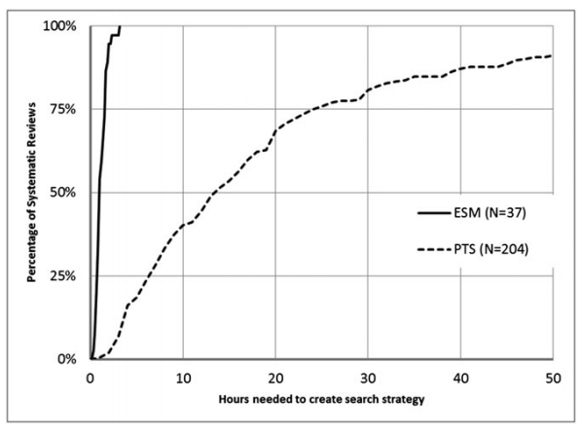
Time needed to create the searches

Slide 71
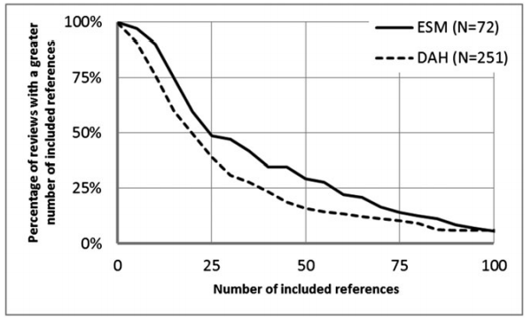
Sensitivity of the searches (included references)

Slide 72
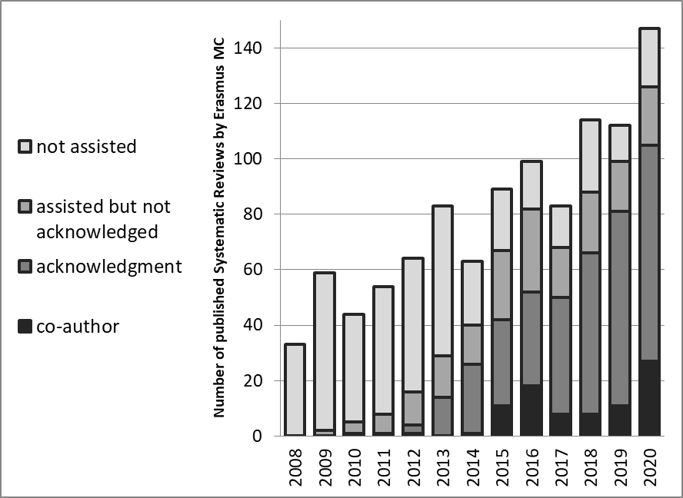
The effect for our institute

Slide 73
Guard your institute’s searches
Medical Library as guardians for your institute’s scientific output!
Goal: Each SR search is seen by at least one librarian
Ideally: Develop all SR searches for your institute
Minimally: Peer review all SR searches by researchers from your institute
and educate researchers on how to do SR searches
Don’t rely on other institute’s librarians to peer review your SRs!
Never turn down a request for help. Not enough time? Ask your boss for more!

Slide 74
Take home message?
Menti.com

Slide 75
Now you: use the method
Give it a go, try this method on one of your clients’ research topics
Don’t expect it to deliver immediately, but let it develop
If you encounter problems, do not hesitate to contact me at w.bramer@erasmusmc.nl or @wichor
And all be invited to EAHIL 2022 in Rotterdam www.eahil2022.nl

